Slide 1
Seminar for the members of Unioncamere Veneto: Opportunities in Vietnam, especially in Binh Duong province
Tomaso Andreatta
HCMC, 27/5/2021

Slide 2
BD tries to develop according to best practice
That is why it leads in Industrial Zones’ services
It is building a new city that is supposed to attract senior staff of companies, not only workers
It is a key members of several international groups of Sustainable Cities
It invests heavily on infrastructure for living (schools, hospitals, university, training) and for logistics (roads, fluvial ports, warehouses, intermodal ports)
It encourages the development of clusters, some of which (shoes, furniture, building materials) are especially similar to those in Veneto
It is well recognized as a progressive and efficient province where doing business is relatively easier

Slide 3
Covid
While Vietnam has until now mostly managed to keep Covid 19 outside, the current situation is worsening fast
Past success and the hope to develop a local vaccine made Vietnam a laggard in terms of inoculating the population
If the US (and EU?) restart business as usual fast, Vietnam may miss most of the opportunity, to the benefit of China, from which it had taken business in the last tow years
Meanwhile logistic is expensive and heavy materials like marble from Vietnam are not making the margins needed

Slide 4
To sell in Asia and in Vietnam one has to be here
Very seldom ad hoc initiatives to stemming from business trips and missions are fruitful
Many distributors are “business card collectors”, they are not focused on your product
Local culture, the need to meet the ultimate boss, “to see to believe” the commitment to sale and especially after-sale service, the language and cultural challenges that require local staff require a permanent presence even to sell (sales office and warehouse with repair engineers)
Since local production is economical and can be more easily tailored to the local markets, it opens up the Asian value chains (Japanese and Korean), there is the possibility to repeat the success we had in Europe supplying Germany’s value chain
More immediate results and market opening than to serve only the local Vietnamese market

Slide 5
EV-FTA
Soon it will be one year old
In principle it brought the immediate cut on 61% of tariffs for European products and 75% on Vietnamese ones
It will still take between 7 and 10 years for all effects of the treaty to be in force
Minimum 40% local content to have benefit from the treaty, may include materials with EU (and South Korean) origins
So far Vietnamese exports, especially shrimp, have soared, while EU machines, even if they had tariff cuts, have slowed down
EVFTA also supports Italian importers of Vietnamese goods. The tariff reduction is faster and wider than that for European goods going to Vietnam

Slide 6
EVFTA and Public Procurement opening
Public procurement should be opened to EU companies:
For all ministries
For EVN and VN Rail
For the 36 national hospitals managed directly by MOH
Half of those for HCMC and Hanoi

Slide 7
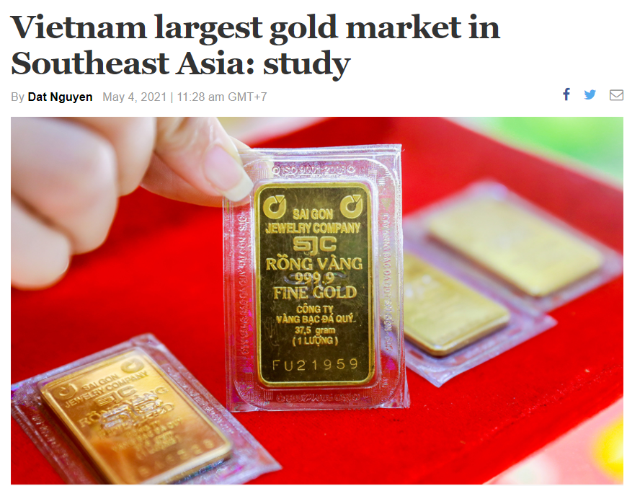
Veneto Districts
Gold: in 2020 Vietnam imported 40 tons of gold
Leader in ASEAN
Also machines for jewelry are in need
Shoes
Geox produces in Vietnam and has local shops in the premium segment, in the expensive malls
To sell made in Italy one needs a strong brand
Furniture
For making volumes and sell to US it makes sense to be in BD/Vietnam
With a brand and distribution channel, Italian furniture sells in Asia
Mechanics
Vietnam is obsessed with Industry 4.0 and automation

Slide 8
Veneto Districts
Cooling
Much of the cold chain is still to be made, Vietnam still has a culture of wet markets, but supermarkets are making very fast growth
Fish
There are several environments like the Po delta in Vietnam
Eels are a local delicacy
Marble
Opportunity for both sides:
Italian marble and machines are premium
Vietnamese marble is plentiful and cheaper
Sport supplies
Vietnam is one of the key producers in the world. Decathlon has tens of supplying factories
Textile
While not a district, important for Veneto. Following the need for local content and exit from China, there are many new textile factories in Vietnam
As to making clothes, it is obvious

Slide 9
Port of Venice?
In the past the port of Venice contacted me to make a bilateral agreement with a Vietnamese port, then no follow up
Here the flows are controlled by the shippers not the ports
Vietnamese ports (Cai Mep/Lac Huyen) are gradually adapting to larger vessels
In 2020, Cai Mep received the MSC Oliver, a 200k DWT, 20000 container ship

Slide 10
Some promising industries where Italy is strong
Wellbeing
In the city culture of being healthy and beautiful and very rapid ageing of a now young population - Cosmetics, Gym and EMS, Esthetic surgery, Food supplements
Food and agriproducts
Italian wine, including Prosecco, is making important gains, food is still mostly sold in expensive shops but supermarkets’ sales are increasing
It is possible to export fresh fruits and vegetables but the bureaucracy is terrible: five years for the first container of apples from Alto Adige
Food processing in Vietnam is of course already importing a lot of Italian machines
Environment and Green Industry
Climate change (especially flooding and salinization) is getting worse
Renewable energy: Vietnam was the world’s star in the last two years
Waste: especially plastics and smog are seen as emergencies
Clean water is next

